Slide 1

The Black Death
Miss Anvieh

Slide 2
Long and Short Term effects of the Black Death

Slide 3

Think →
There are insufficient sources
No-one has investigated where there are detailed records like in China
Historians have mainly focused on Europe
Most of the research that has been done is available to only those who speak English
Why do we know more about the impacts of the Black Death in Europe than Asia and Africa?

Slide 4

Short term impacts - Depopulation
Exact figure for the number of people who died from the Black Death are unknown but estimates suggest
33 to 40% of the population of Europe died
28% of the population in China
30% of the population in the Middle East
40% of Egypt’s population

Slide 5

Short term impacts - religion
Many monks, nuns and priests died
Many thought this was proof that the lifestyles of these people had displeased God
Some priests ran away from the disease and those who replaced them were not trained
The power of the church began to weaken

Slide 6
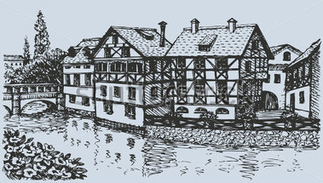
Short term impacts – Effects on towns
Rubbish and raw sewage in the streets increased
Few people were alive to make repairs so the towns fell apart

Slide 7
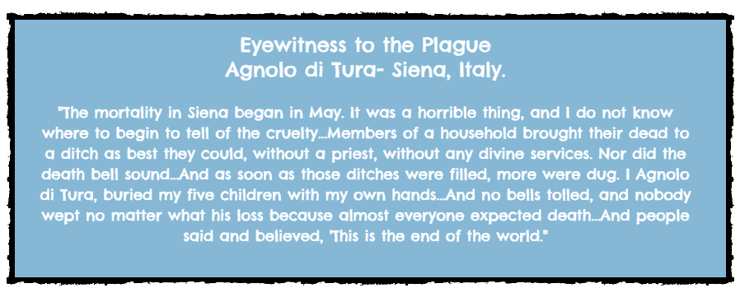
Short term impacts – Burial of the dead
High number of deaths means that people were not given proper burials
Mass burials became common

Slide 8
Long term impacts
Weakening of feudalism
Peasants’ Revolt
Weakening of the Church
Start of the slave trade
Foundations of the Renaissance

Slide 9
Create a PowToon that addresses the following questions
Must be more than 7 minutes long must include sufficient information and should visually appealing.
What was life in the 14th Century like?
How advanced was medical knowledge in the 14th Century?
What is the Black Death and where did it originate?
How did it spread?
What are the symptoms?
What were some responses to the Black Death?
How was it treated?
What were the impacts of the Black Death (both positive and negative)?

Slide 10
Create a Rap (use fresh prince of bel-air tune)
http://www.teachertube.com/video/the-black-death-rap-399501?utm_source=video-google&utm_medium=video-view&utm_term=video&utm_content=video-page&utm_campaign=video-view-page

